Slide 1


Shri Ramdeobaba College of Engineering & Management, Nagpur
Department of Computer Science & Engineering(AIML)
Session 2022-2023
SEMINAR
ON
Pest Classification using Deep Learning
Presented By:
Group No :- 8
Mr. Yash Lichade
Mr. Vinaykumar Pillai
Mr. Yash Damdu
Mr. Saksham Lanjewar
Guided By:
Prof. Abhishek R. Sahu

Slide 2
1. Introduction
Aim :-
To Develop a precise pest classification system for agriculture using Deep Learning and CNNs to enhance crop protection and increase agricultural productivity.
Author and Year | Title | Findings | Limitations
Li Zhiyong , 2022 | Classification Method of Significant Rice Pests Based on Deep Learning. | The paper proposes a classification method for rice pests using deep learning and data augmentation techniques. | Paper introduces rice pest classification, limited by dataset issues, lacks method comparisons, generalization, and practical implementation insights.
Witenberg Santiago Rodrigues Souza , 2019. | A Deep Learning Model for Recognition of Pest Insects in Maize Plantations. | The paper presents a deep learning model, Inception-V3*,for the recognition of pest insects in maize plantations. | The paper does not provide details about the size of the dataset used for training and testing the deep learning model, which could affect the generalizability of the results.

Slide 3
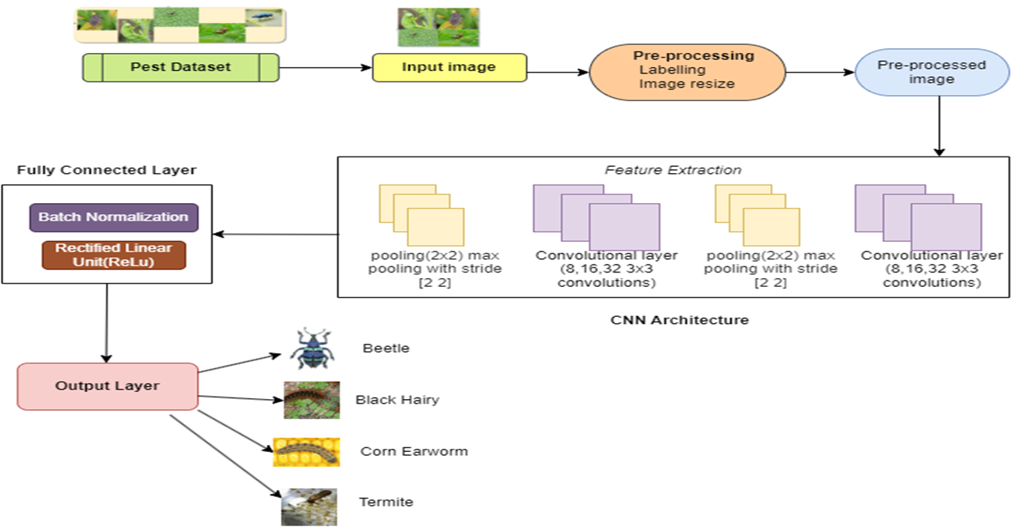
2. Proposed METHEDOLOGY

Slide 4
4. Result
Improved Pest Detection: The system should be able to accurately and efficiently identify various types of pests and weeds ,including insects, and other crop threats, from images.
Reduced Pesticide Usage: By accurately identifying pests and weeds, farmers can target their pesticide usage, reducing the overall amount of chemicals used in agriculture.
Cost Savings: By optimizing pest management, the system can potentially save farmers money on pesticides and other inputs, as well as reduce labor costs.
Scalability: The system should be designed to be scalable and adaptable to different types of crops and agricultural settings.
User-Friendly Interface: An easy-to-use interface for farmers and agricultural workers to interact with the system is an expected outcome, making it accessible and practical for real-world use.

Slide 5
3. Technology
1. Programming language:
• Python
2. Library/Framework:
• TensorFlow (Keras)
• Pandas , NumPy and Matplotlib (Data Processing and Visualization)
3. Tools/Platforms:
• Jupyter Notebook
• Google Colab

Slide 6
5. References
1. Souza, Witenberg SR, Adão Nunes Alves, and Dıbio Leandro Borges. "A deep learning model for recognition of pest insects in maize plantations." In 2019 IEEE International Conference on Systems, Man and Cybernetics (SMC), pp. 2285-2290. IEEE, 2019.
2. Malek, Md Abdul, Sanjida Sultana Reya, Md Zahid Hasan, and Shakhawat Hossain. "A crop pest classification model using deep learning techniques." In 2021 2nd International Conference on Robotics, Electrical and Signal Processing Techniques (ICREST), pp. 367-371. IEEE, 2021.
3. Li, Zhiyong, Xueqin Jiang, Xinyu Jia, Xuliang Duan, Yuchao Wang, and Jiong Mu. "Classification Method of Significant Rice Pests Based on Deep Learning." Agronomy 12, no. 9 (2022): 2096.
4. Song, Yiyun, XinYing Duan, Yan Ren, Jingwen Xu, Lijun Luo, and Dongyu Li. "Identification of the agricultural pests based on deep learning models." In 2019 International Conference on Machine Learning, Big Data and Business Intelligence (MLBDBI), pp. 195-198. IEEE, 2019.

Slide 7
Thank You

